Slide 1
HER3 knockdown gene expressions
BRAF inhibitors review
Colon cancer cells used in LINCS
Databases review
Rachel Liu, 1st year BSTP
Rotation 1, August 2025
Dr. Rui Wang’s Lab

Slide 2
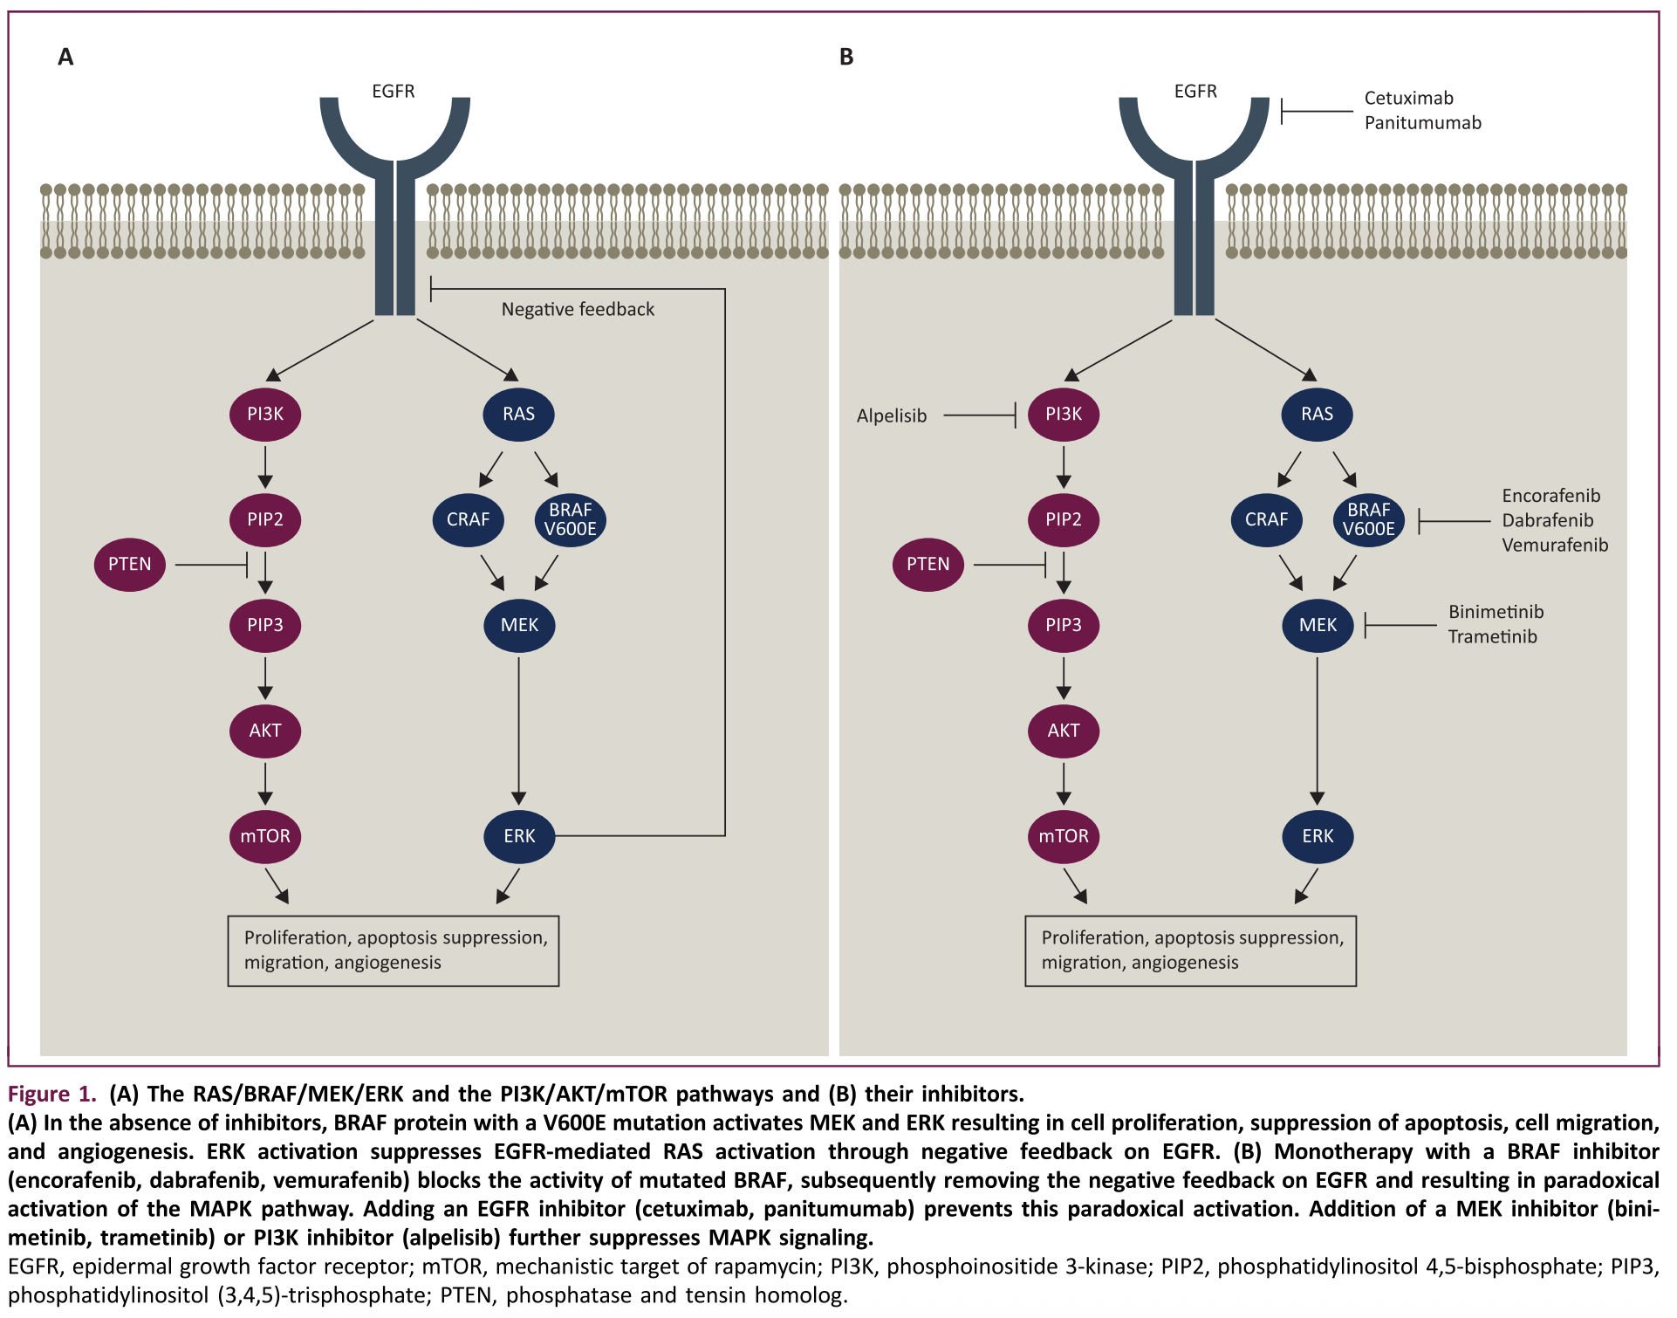
BRAF mutation in CRC
1. Grothey et al. (2021)
Notes:
As explained in this figure, the BRAF protein with the V600E mutation activates MEK (Mitogen-activated protein kinase kinase (also known as MAP2K or MKK) and ERK (extracellular signal-regulated kinase) (all happening in the cytoplasm) → results in cell proliferation, suppression of apoptosis, cell migration, and angiogenesis that’s done in the nucleus. This is known as the MAPK (mitogen-activated protein kinase) pathway (blue) where the red is known as the PI3K/AKT/mTOR signaling pathway
ERK activation suppresses EGFR-mediated RAS (rat sarcoma) activation – as part of a negative feedback loop.
EGFR = epidermal growth factor receptor (on the cell surface)
Monotherapy with a BRAF inhibitor blocks the activity of mutated BRAF, however that results in a paradoxical activation of the MAPK pathway through CRAF (RAF proto-oncogene serine/threonine-protein kinase). Adding an EGFR inhibitor prevents this paradoxical activation, in addition to a MEK inhibitor
Here we’ve introduced some FDA approved BRAF inhibitors so we’ll move on to what will probably be my favourite part of the discussion – pharmacology and discussing dabrafenib, vemurafenib and encorafenib

Slide 3
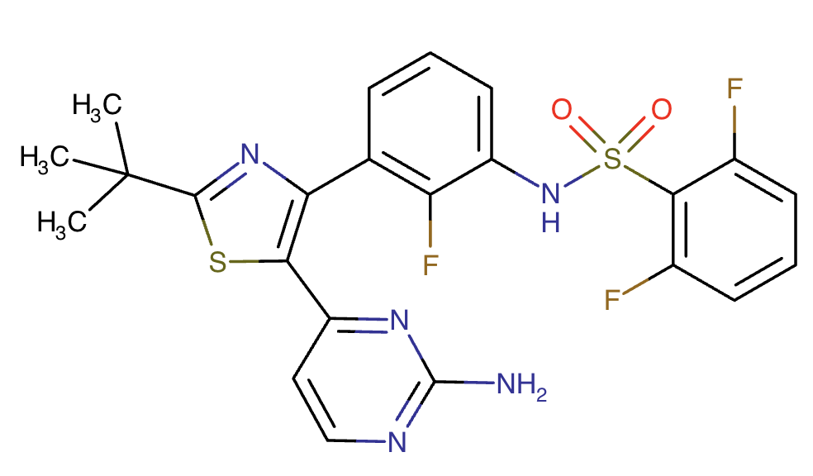
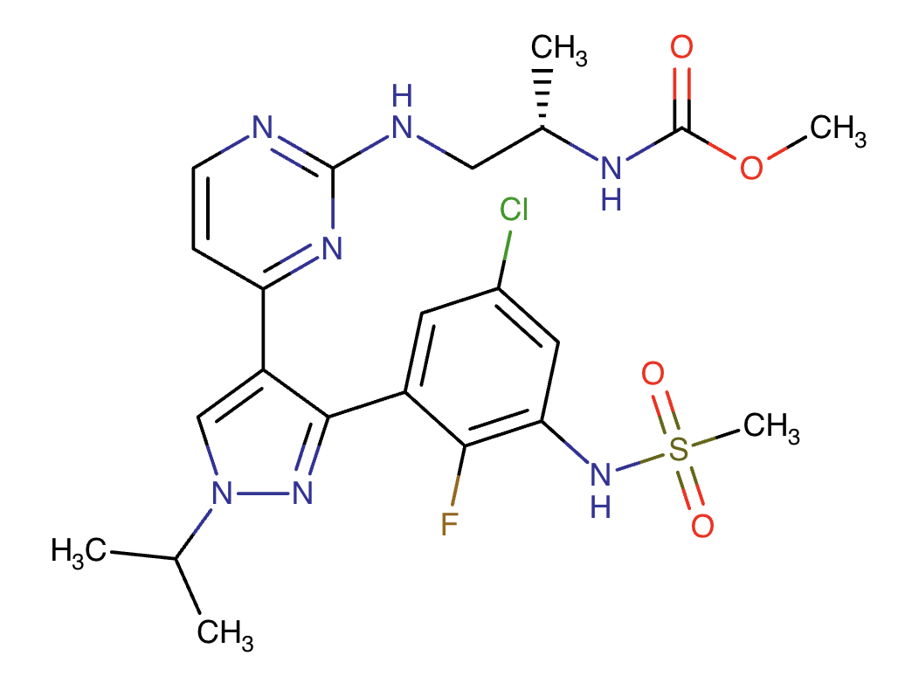
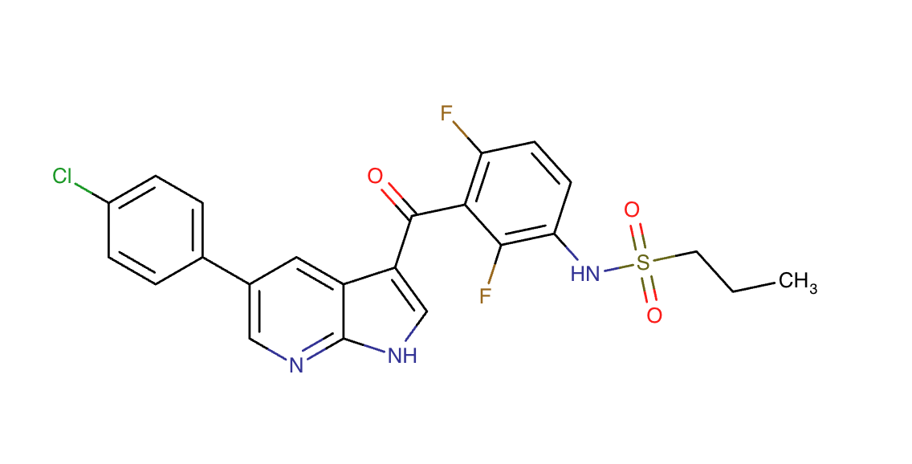
BRAF inhibitors
Vemurafenib
Dabrafenib
Encorafenib
https://go.drugbank.com/drugs/DB08881
https://go.drugbank.com/drugs/DB08912
https://go.drugbank.com/drugs/DB11718
Vemurafenib. Lexi-Drugs. UpToDate Lexidrug. UpToDate Inc. https://online.lexi.com. Accessed Jul 29, 2025
Dabrafenib. Lexi-Drugs. UpToDate Lexidrug. UpToDate Inc. https://online.lexi.com. Accessed Jul 29, 2025
Encorafenib. Lexi-Drugs. UpToDate Lexidrug. UpToDate Inc. https://online.lexi.com. Accessed Jul 29, 2025
Notes:
It exerts its function by binding to the ATP-binding domain of the mutant BRAF. Vemurafenib was co-developed by Roche and Plexxikon
Small molecule
First approved by FDA August 17, 2011
Indications: Erdheim-Chester disease with BRAF V600 mutation, Hairy cell leukemia (relapsed or refractory), Langerhans cell histiocytosis, BRAF V600 mutated), Melanoma (unresectable or metastatic), NSCLC (relapsed/refractory with BRAF V600 mutation)m Thyroid cancer (papillary, recurrent or metastatic, BRAF V600E mutated)
NOTE: CRC IS NOT LISTED HERE
NEXT: dabrafenib!
reversible ATP-competitive kinase inhibitor and targets the MAPK pathway
Dabrafenib is a competitive and selective BRAF inhibitor by binding to its ATP pocket. Although dabrafenib can inhibit wild-type BRAF, it has a higher affinity for mutant forms of BRAF, including BRAF V600E, BRAF V600K, and BRAF V600D. BRAF is a serine/threonine protein kinase and is involved in activating the RAS/RAF/MEK/ERK or MAPK pathway, a pathway that is implicated in cell cycle progression, cell proliferation, and arresting apoptosis
Indications:
melanoma adjuvant treatment, with BRAF V600E or V600K mutation
Melanoma unresectable or metastatic
NSCLC, metastatic, with BRAF V600E mutation
Solid tumours, unresectable or metastatic, with BRAF V600E mutation
Thyroid cancer, anaplastic, locally advanced, or metastatic with BRAF V600E mutation
Typical dose: 150 mg PO BID monotherapy or in combo with trametinib (MEK inhibitor)
No usual dose adjustment for kidney or liver dysfunction but has dosage adjustments for toxicity
NOT used in CRC – studied with trametinib target two different kinases in the RAS/RAF/MEK/ERK pathway, however in the setting of BRAF-mutant colorectal cancer, induction of EGFR-mediated MAPK pathway re-activation has been identified as a mechanism of intrinsic resistance to BRAF inhibitors
Okay, Encorafenib! FDA approved Jun 27, 2018 (first for melanoma)
THEN received approval Apr 8, 2020 for mCRC in combo with cetuximab from the BEACON trial (! First BRAF inhibitor to be approved for mCRC! – as second line + )
Encorafenib is a kinase inhibitor that targets BRAF V600E, as well as wild-type BRAF and CRAF in in vitro cell-free assays with IC50 values of 0.35, 0.47, and 0.3 nM, respectively. Mutations in the BRAF gene, such as BRAF V600E, can result in constitutively activated BRAF kinases that may stimulate tumor cell growth. Encorafenib was also able to bind to other kinases in vitro including JNK1, JNK2, JNK3, LIMK1, LIMK2, MEK4, and STK36, and reduce ligand binding to these kinases at clinically achievable concentrations
Indications:
mCRC, BRAF V600E mutation
Melanoma, unresectable or metastatic, with BRAF V600E or V600K mutation
NSCLC, metastatic, with BRAF V600E
What makes encorafenib stand out from the rest? Highly selective, ATP-competitive, small-molecule BRAF inhibitor with anti­proliferative and apoptotic activity in tumor cells expressing BRAF V600E mutations and has longer pharmacodynamic activity than other approved BRAF inhibitors.

Slide 4
BRAF inhibitors - Summary
Drug name & Structure | FDA approved | Indications (mainly unresectable, metastatic with BRAF V600E mutation) | Common adverse effects | Dosing | Clinical Evidence in CRC
Vemurafenib | Aug 17, 2011 | Erdheim-Chester disease Hairy cell leukemia Langerhans cell histiocytosis Melanoma NSCLC Thyroid cancer | Rash Diarrhea Nausea Vomiting Fatigue Headache Fever | Twice daily | Clinical trials limited to small cohorts of CRC patients with limited benefit
Dabrafenib | May 29, 2013 | Melanoma (adjuvant & metastatic) NSCLC Solid tumours Thyroid cancer |  | Twice daily
Encorafenib | June 27, 2018 | mCRC Melanoma NSCLC |  | Once daily, with cetuximab | BEACON trial (NEJM, 2019) BREAKWATER Trial (NEJM, 2024)
Encorafenib | June 27, 2018 | mCRC Melanoma NSCLC
Notes:
This slide is a lot; it basically sums up what I spoke verbally in the last 3 slides
Overall, BRAF inhibitors haven’t been used much in mCRC because of the EGFR feedback upregulation caused by BRAF blockade
Promise with using combination therapy with MEK inhibitors +/- EGFR inhibitors
Used in the clinical trial setting but no FDA approved indications yet except for encorafenib (which is only used in combo)
As explained previously, activation of phosphatidylinositol 3-kinase (PI3K)/AKT pathway has also been implicated resistance to BRAF inhibitor both melanoma and CRC cell line
If there aren’t any more questions or comments, I’m going to move on
Erdheim-Chester disease = rare disorder characterized by the abnormal buildup of histiocytes, a type of white blood cell, in various tissues and organs. It's considered a histiocytic neoplasm. While previously thought to be inflammatory, it's now recognized as a clonal hematopoietic neoplasm, often linked to mutations in BRAF V600E.

Slide 5
LINCS Database

Slide 6
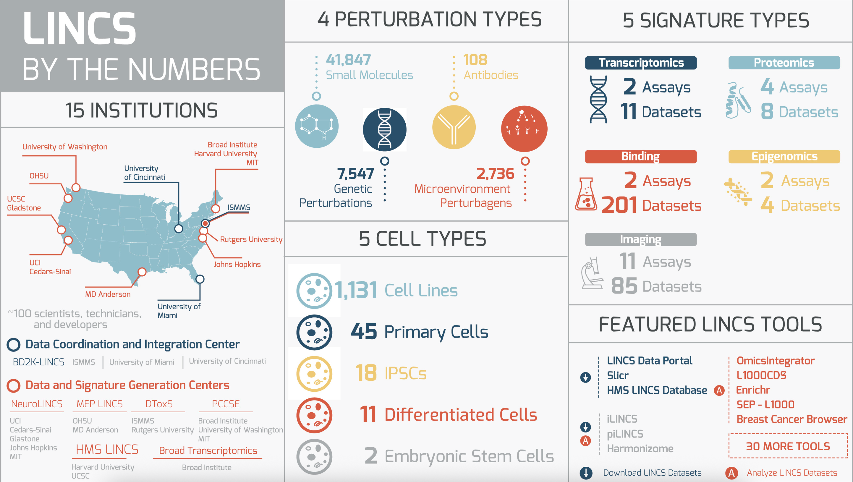
NIH. NIH LINCS program. https://lincsproject.org/LINCS/about (accessed Aug 1, 2025)
Keenan et al (2018)
Notes:
The LINCS Consortium is an NIH Common Fund program
Overview of the program: The NIH Library of Integrated Network-Based Cellular Signatures (LINCS) program aims to create a network-based understanding of human biology by cataloging changes in gene and protein expression, signaling processes, cell morphology, and epigenetic states, which occur when cells are exposed to a variety of perturbing agents. By generating and providing publicly available data on how human cells respond to various genetic and environmental stressors, the LINCS program is collecting the data required for detailed understanding of cell signaling and gene regulatory pathways involved in human disease.
LINCS datasets consist of assay results from cultured and primary human cells treated with bioactive small molecules, ligands such as growth factors and cytokines, or genetic perturbations.
Many different assays are used to monitor cell responses, including assays measuring transcript and protein expression; cell phenotype data are captured by biochemical and imaging readouts. Assays are typically carried out on multiple cell types, and at multiple timepoints; perturbagen activity is monitored at multiple doses.
Some of the applications include facilitating the identification of biological targets for new disease therapies
---
Results are obtained in cultured and primary cells whose state has been perturbed experimentally, with the term “perturbagen” used to refer to any condition that can alter the cellular state. LINCS datasets therefore consist of assay results from cells treated with bioactive small molecules, antibodies, and ligands, such as growth factors and cytokines, microenvironment proteins, genetic perturbations, and comparisons of disease versus normal primary cells from patients and healthy control subjects. Many different assays are used to measure cell responses, including measurements of mRNA and protein expression; epigenomic status; and cellular, molecular, and morphological phenotypes captured by biochemical and imaging readouts

Slide 7
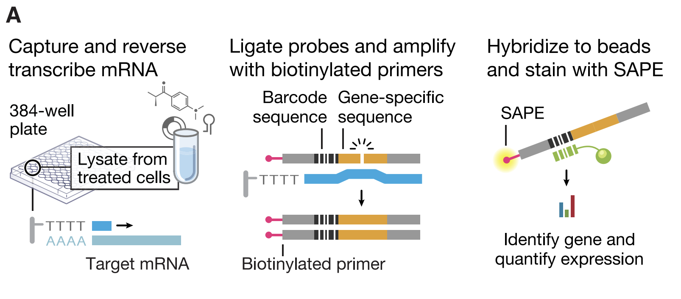
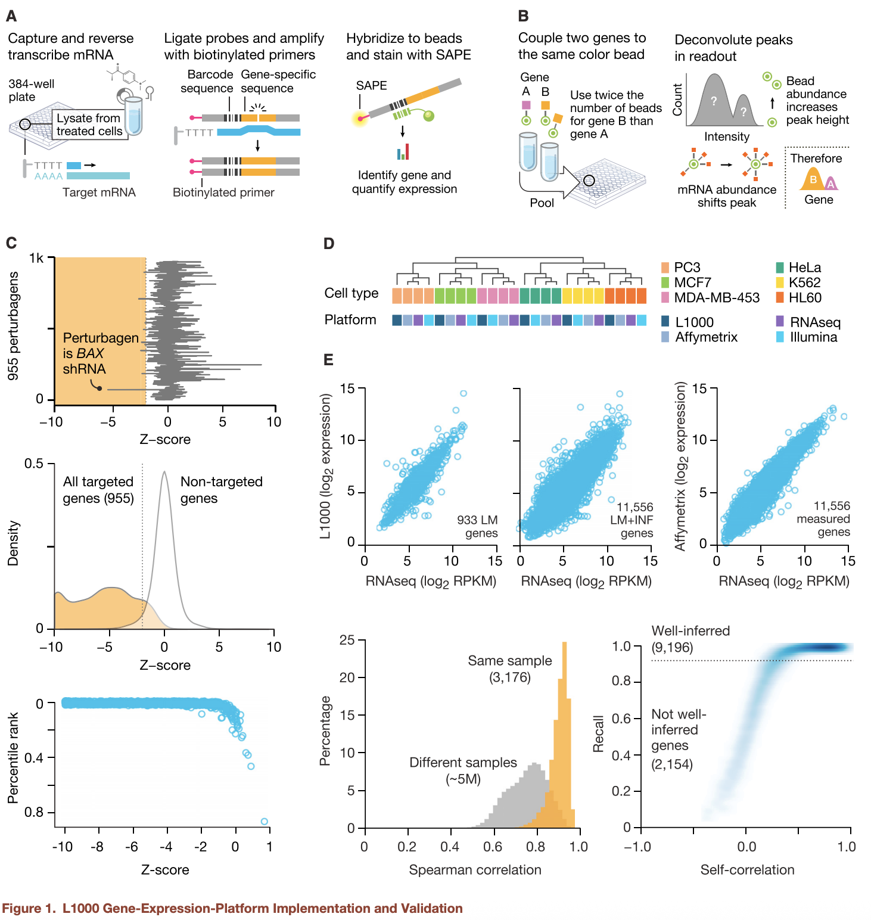
1. Subramanian et al. (2017)
Notes:
The L1000 assay is a cost-effective, high-throughput (fast, scalable, cost-efficient) method to measure gene expression across thousands of perturbations.
Instead of full RNA-seq, it focuses on 978 carefully chosen “landmark” genes. These were selected by analyzing over 12,000 microarray profiles and found to capture about 82% of transcriptomic variance.
From these landmarks, expression of ~11,000 other genes is computationally inferred — allowing massive scale at lower cost.
The workflow is as follows: Cells are plated in 384-well plates, treated with a compound, and lysed after 6 hours. mRNA is captured using oligo-dT beads, reverse transcribed to cDNA, and hybridized with barcoded probes targeting the 978 genes. After PCR amplification, each product binds to a uniquely colored bead. A fluorescent signal reflects gene abundance, and a Luminex machine reads both the bead color (gene ID) and signal intensity (expression level).
Think of it like giving each gene a barcode and then photocopying those barcodes many times so they can be read accurately and cheaply.
---
The L1000 assay is a cost-effective, high-throughput method developed by the Broad Institute to measure gene expression from thousands of perturbation experiments. It focuses on 978 carefully selected 'landmark genes', using a barcoding system instead of full RNA-seq
After analyzing over 12,000 microarray profiles from GEO to determine an optimal number of measured genes (landmarks).
Found that 1,000 carefully chosen transcripts capture ~82% of the full transcriptome variance
Introduces a cost-effective, scalable platform called L1000, measuring ~978 landmark genes and inferring the rest (~11,350 genes) to create a massive Connectivity Map (CMap-L1000) dataset of over 1.3 million expression profiles generated from ~42,000 perturbagens across multiple cell lines
Enable systematic exploration of gene–drug–disease relationships at unprecedented scale
Title: "Step 1: Capturing and Amplifying Gene Expression"
Cells are treated with a drug in 384-well plates.
Cells are lysed, and mRNA is captured using oligo-dT beads (binds to poly-A tail of mRNA).
mRNA is reverse transcribed to cDNA.
Then, special probes with barcodes target 978 specific "landmark" genes.
The signal is amplified by PCR and prepared for detection.
Analogy: Like attaching a name tag (barcode) to each gene, then photocopying those tags a bunch of times so we can see them clearly.
(A) The L1000 Core Assay: From Cells to Gene Signal
Cells are plated, treated with small molecules (drugs) in 384-well plates.
After 6h (standard), cells are lysed in the well.
mRNA is captured using oligo-dT primers on a solid phase (selects polyA+ transcripts).
Reverse transcription generates cDNA.
Custom DNA probes (with a barcode unique to each gene) hybridize to the cDNA.
Ligated probes are PCR amplified using universal primers.
Amplified product is hybridized to beads (each bead color = a landmark gene).
Fluorescent readout (phycoerythrin) gives a quantitative signal of transcript abundance.
Luminex FlexMap 3D reads both the bead color (gene ID) and fluorescence intensity (expression)

Slide 8
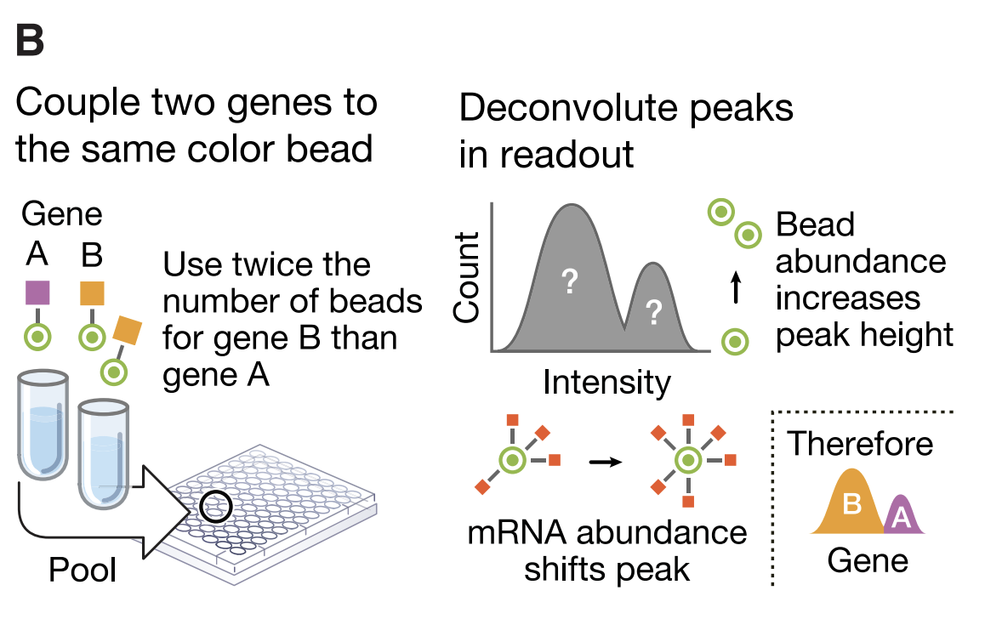
1. Subramanian et al. (2017)
Notes:
How did they measure gene expression?
Detection with Barcoded Beads (Fig. 1B)
Title: "Step 2: Measuring Expression with Color-Coded Beads"
Each gene barcode is captured by a microsphere (bead) that recognizes it.
Since there are only 500 bead colors, two genes are measured per color.
Beads are loaded in a 2:1 ratio, and a machine (Luminex scanner) reads:
Color = which gene
Fluorescence intensity = how much gene expression
They use k-means clustering to separate the two genes.
Analogy: Like scanning two people with the same color shirt at a party, but one group is twice as big—so you can tell which group is which based on crowd size
(B) Bead Multiplexing for 1,000 genes with only 500 bead types
Because the Luminex system supports only 500 distinct bead colors:
Each color is shared between 2 genes, in a 2:1 ratio.
K-means clustering separates two peaks in fluorescence intensity.
The gene with twice as many beads forms the larger peak, allowing disambiguation.
Objective: double the number of readable genes per scan, without increasing bead types.

Slide 9
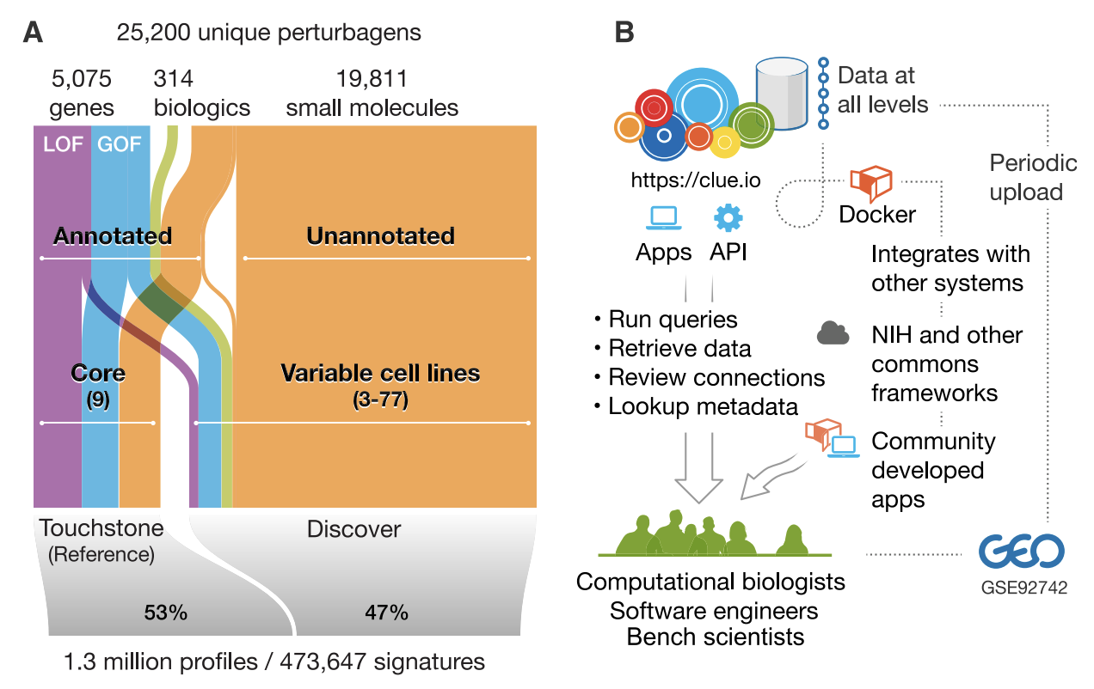
1. Subramanian et al. (2017)
Notes:
(1) Expand the Number of Perturbagens
From 164 drugs → now 19,811 small molecules (FDA-approved, research tools, and NIH screen libraries)
Also added:
18,493 shRNAs
3,462 overexpression constructs (cDNAs)
314 biologics (e.g., cytokines, antibodies)
Each one = a different "perturbagen" tested for its effect on gene expression
shRNA (short hairpin RNA) = Gene Knockdown
18,493 shRNAs were used to reduce expression of specific genes.
Each gene was typically targeted with 3 different shRNAs to control for off-target effects.
Purpose: Simulate loss-of-function and observe how that changes gene expression downstream.
Building a dataset that answers the question: “What happens to the cell’s gene expression program if we turn this gene down?”
cDNA Overexpression = Gene Upregulation
3,462 cDNAs were used to increase expression of specific genes.
Each cDNA represents a wild-type version of a gene cloned into an expression vector.
Purpose: Simulate gain-of-function.
Building a dataset that answers the question: “What happens if we crank this gene up well above normal levels?”
Goal of Both Perturbations:
Whether you knock a gene down (shRNA) or up (cDNA), the core question is:
"What downstream gene expression changes occur?"
This gives you a transcriptional signature for each perturbation.
Why Both Are Useful:
Together, they let you probe:
Function of genes: What happens when you lose or gain activity?
Directionality: Does a phenotype require a gene's presence or absence?
Drug–gene relationships: Does a drug mimic a knockdown or an overexpression?
For example:
If a drug's signature resembles the shRNA knockdown of gene X → maybe that drug inhibits gene X.
If a drug mimics the overexpression of gene Y → maybe it activates or stabilizes Y.
(2) Expand the Perturbation Types
Genetic perturbations: Knockdown (shRNA) and overexpression (cDNA)
For genes selected due to disease/pathway relevance: 5,075 genes
Used triplicate experiments and standardized timepoints:
Small molecules: 6h or 24h → captures early, primary transcriptional responses to a drug or gene change (e.g. immediate signaling, stress response) for 6 hours. For 24 hours, captures longer-term transcriptional shifts, feedback loops, and more stable gene expression changes
Genetic perturbations: 96h → post-infection for shRNA knockdowns and cDNA overexpression for 96h allows for enough time to ensure downstream gene expression changes can be captured
(3) Expand the Number of Cell Lines
Not just one cancer cell line anymore.
Built two key datasets:
Touchstone v1: Carefully annotated subset of perturbagens tested across 9 core cell lines (for broad biological diversity, drug responsiveness and easy growth)
Discovery v1: Broader screen of uncharacterized compounds, tested variably in 3–77 cell lines
These include a mix of cancer and non-cancer lines (e.g., MCF7, PC3, HeLa, HL60).
Outcome: CMap-L1000v1
1,319,138 L1000 gene expression profiles
From:
42,080 perturbagens
Yielding 473,647 consolidated signatures (i.e., consensus profiles from triplicates)
Over 1,000x larger than the original CMap (2006)
Available at:
GEO: GSE92742
CLUE platform: https://clue.io
Why Did They Do This?
Once they proved L1000 is reliable, they used it to build a massive, searchable library of how thousands of perturbations (drugs, genes, etc.) affect gene expression.
This enables:
MOA (mechanism of action) discovery
Drug repurposing
Resistance signature analysis (e.g., Figure 7)
Similarity queries (which genes/drugs yield similar signatures?)

Slide 10
Colon Cancer Cell Lines

Slide 11
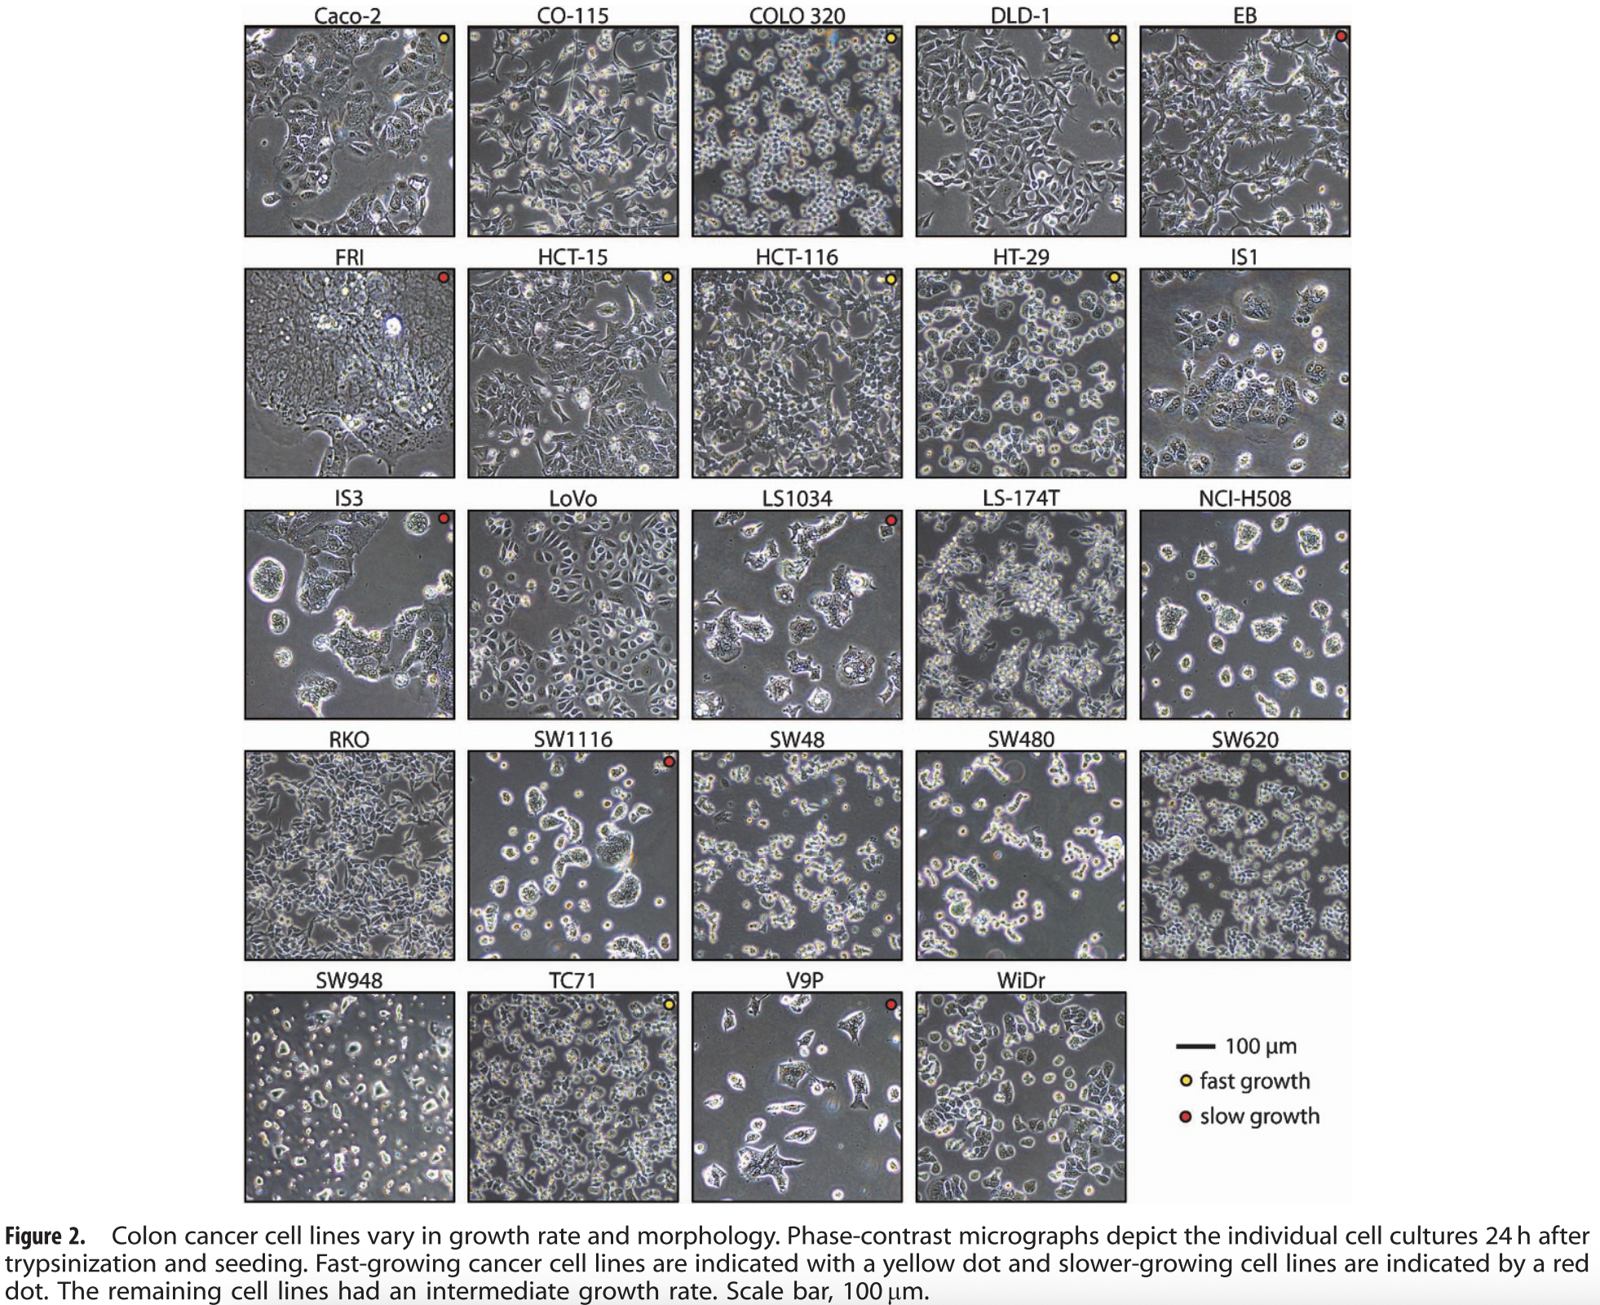
1. Ahmed, D., Eide, P. W., Eilertsen, I. A., Danielsen, S. A., Eknæs, M., Hektoen, M., Lind, G. E., & Lothe, R. A. (2013). Epigenetic and genetic features of 24 colon cancer cell lines. Oncogenesis, 2. https://doi.org/10.1038/oncsis.2013.35
Notes:
Briefly discuss different cancer cell lines here and the differences to explain the limitations – colon cancer cell lines

Slide 12
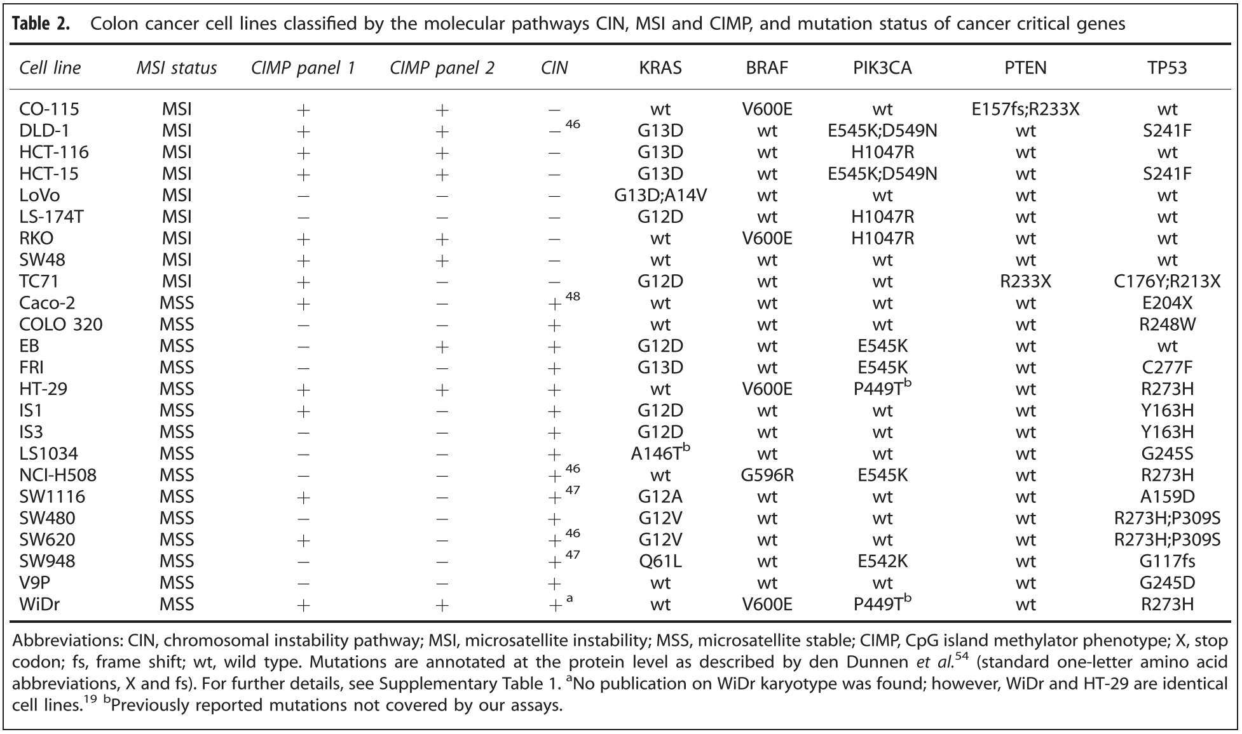
1. Ahmed, D., Eide, P. W., Eilertsen, I. A., Danielsen, S. A., Eknæs, M., Hektoen, M., Lind, G. E., & Lothe, R. A. (2013). Epigenetic and genetic features of 24 colon cancer cell lines. Oncogenesis, 2. https://doi.org/10.1038/oncsis.2013.35

Slide 13
Less studied colon cancer cell lines
Other Colon Cancer Cell Lines
SNU series (SNU4, SNU, SNU1040) | Seoul National University – from Korean cancer patients since 1982¹
GP2d² | Poorly differentiated colon carcinoma from 71 yo female at surgical resection Received no preoperative chemo or radiotherapy Strong family history of colon cancer From UK Used for predicting modelling anticancer drug sensitivity
MDST8³ | From UK Used for cancer gene therapy studies and tumour biology assays
Ku JL, Park JG. Biology of SNU cell lines. Cancer Res Treat. 2005 Feb;37(1):1-19. doi: 10.4143/crt.2005.37.1.1. Epub 2005 Feb 28. PMID: 19956504; PMCID: PMC2785416.
https://www.culturecollections.org.uk/nop/product/gp2d#:~:text=GP2d%20has%20been%20established%20from,old%20female%20at%20surgical%20resection.
https://www.culturecollections.org.uk/nop/product/mdst8

Slide 14
Pancreatic Cancer Cell Lines (FYI)

Slide 15
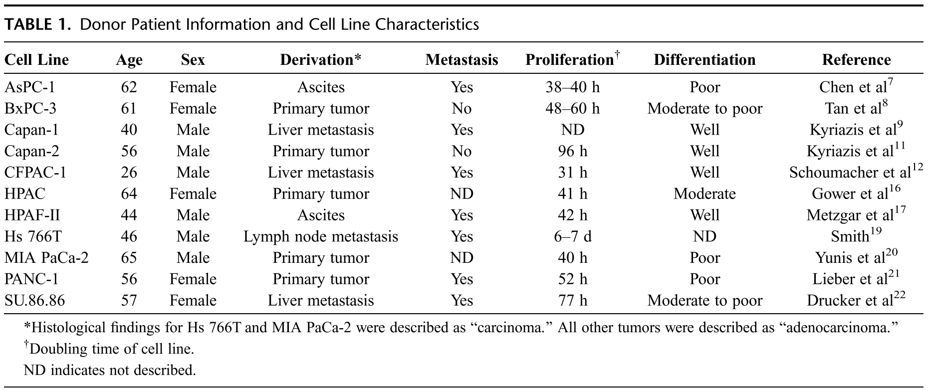
Pancreatic cancer cell lines
YAPC | 43 | Male | Ascites | ND | ~48h | ND | https://www.cellosaurus.org/CVCL_1794
Deer, E. L., González-Hernández, J., Coursen, J. D., Shea, J. E., Ngatia, J., Scaife, C. L., Firpo, M. A., & Mulvihill, S. J. (2010). Phenotype and Genotype of Pancreatic Cancer Cell Lines. www.pancreasjournal.com
https://www.cellosaurus.org/CVCL_1794
Notes:
Pancreatic cancer cell lines

Slide 16
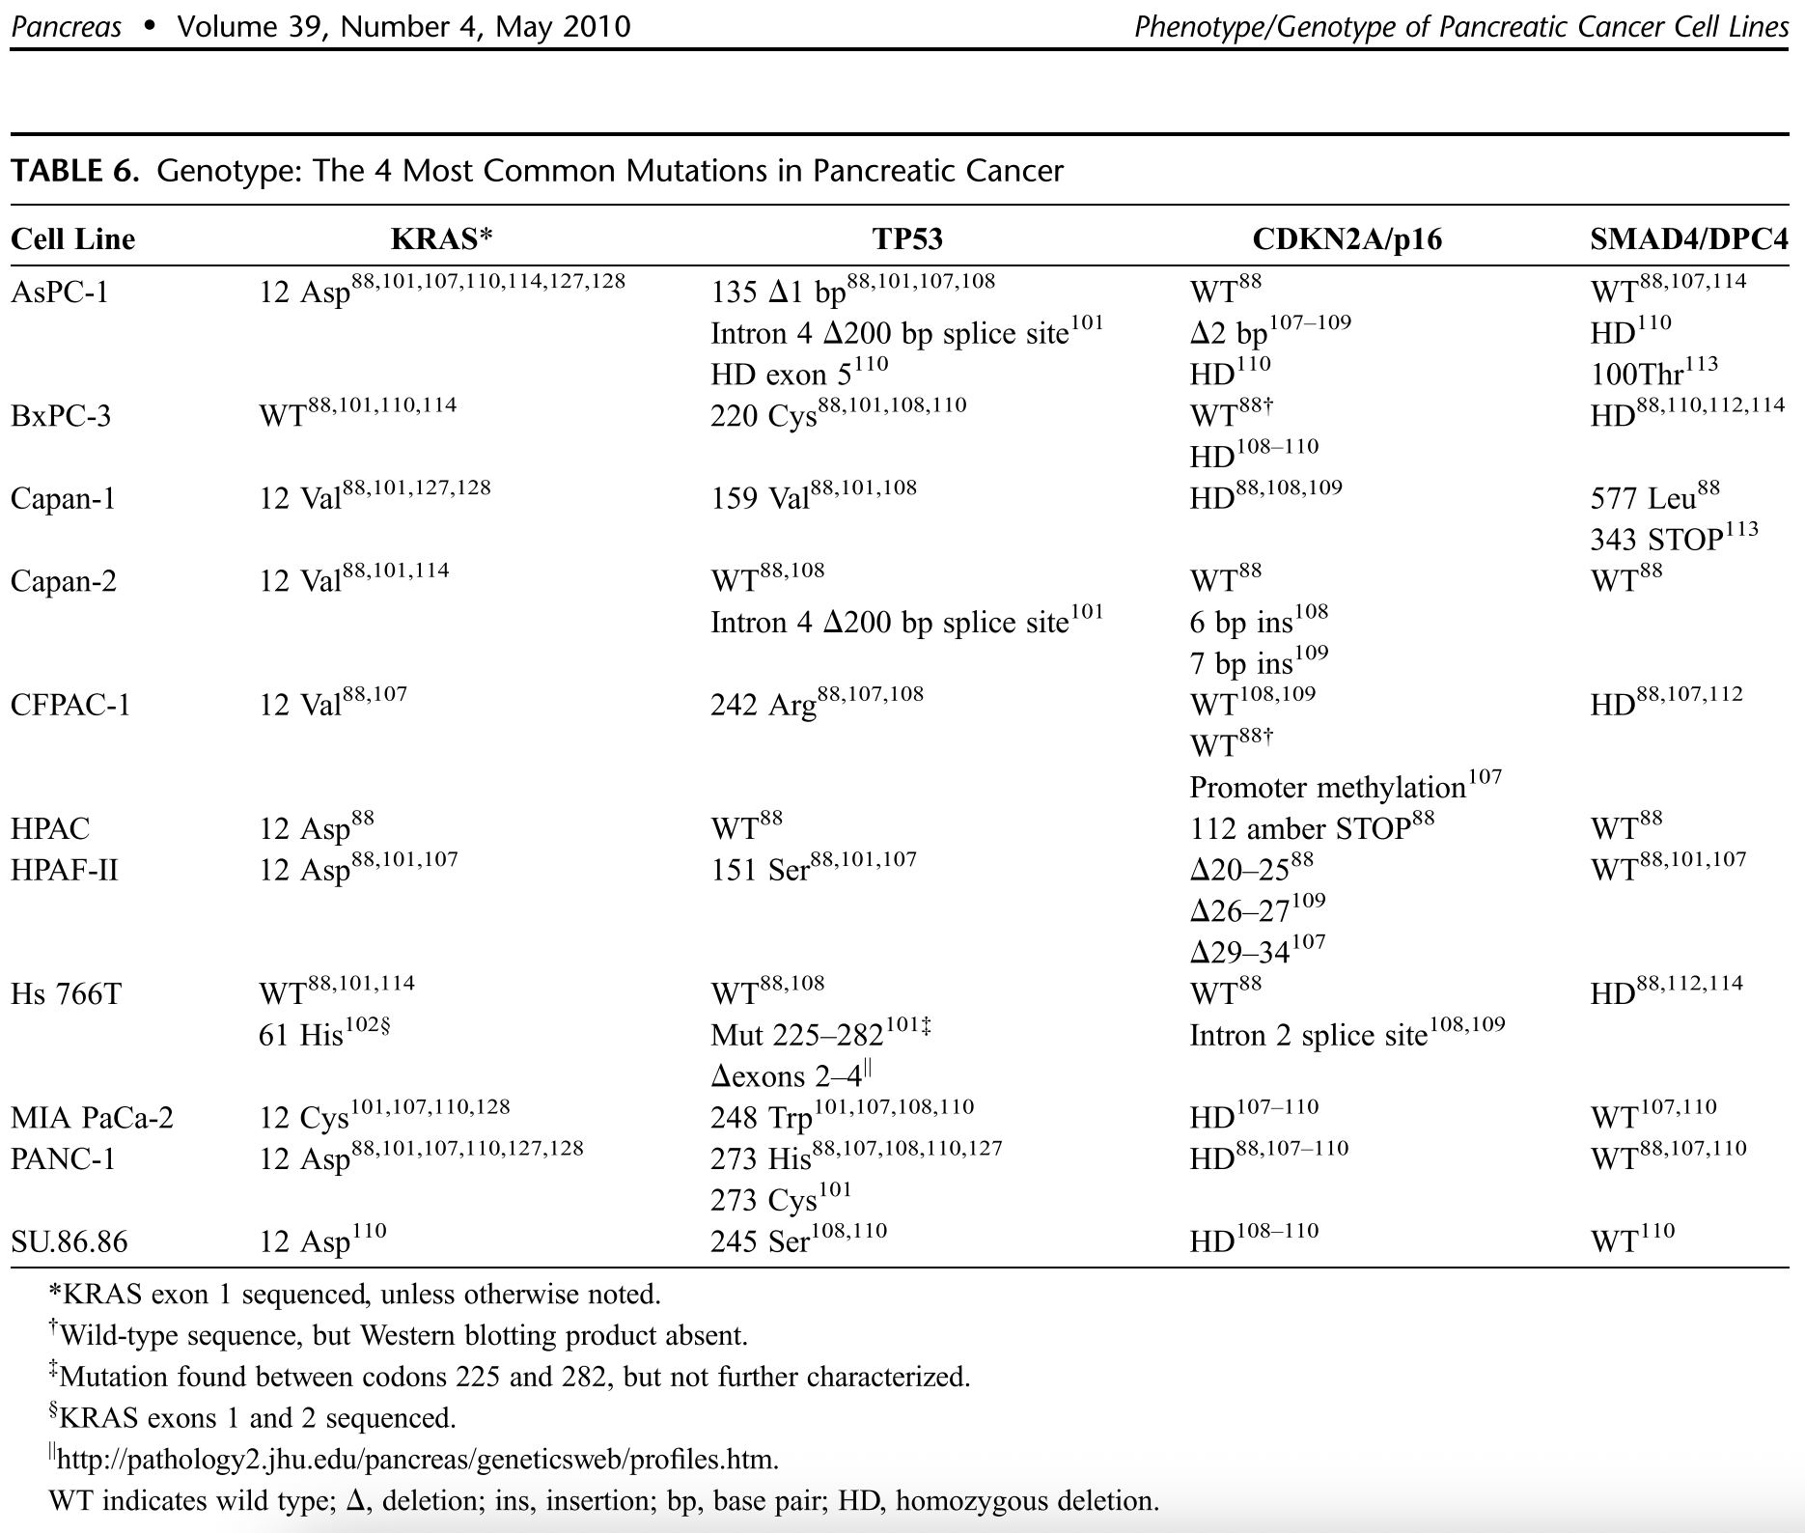
YAPC | Gly 12 Val (c35G>T) | His 179 Arg (c536A>G) | ND | ND
Deer, E. L., González-Hernández, J., Coursen, J. D., Shea, J. E., Ngatia, J., Scaife, C. L., Firpo, M. A., & Mulvihill, S. J. (2010). Phenotype and Genotype of Pancreatic Cancer Cell Lines. www.pancreasjournal.com
https://www.cellosaurus.org/CVCL_1794

